Slide 1
ACLC Test Banking

Slide 2
ACLC Test Banking provide an easier and faster way to create test questionnaire, table of specification and syllabi compared to the manual process. All questions approved by the Dean will be stored on the system and can be reuse when creating new test questionnaire. The checking process will be more faster, flexible and paper less with notification features.

Slide 3
Process
INSTRUCTOR
Syllabus revise notification
DEAN
PRINTING INCHARGE
Submit TQ for printing
Create Syllabus
Syllabus approve notification
SYLLABUS
Create TOS
if Syllabus is approved
Submit Syllabus for checking
Submit to Dean for final checking
Submit back to PH if TQ needs revision
TOS
Create TQ after creating TOS
TQ
PH
Submit TQ for checking
TQ revise notification
TQ Printed notification

Slide 4
MODULES

Slide 5
DASHBOARD – TQ Statistics (monthly submission, test type usage).
SYLLABUS – Create, Edit, Copy Syllabus(College Only).
Can Create new Syllabus
Can Copy stored Syllabus
Can Edit Created Syllabus
College TQ - Create, Edit, Copy TOS & TQ for College.
Can Create new TOS (If Syllabus is approved)
Can Create new TQ (If TOS is set)
Can Edit Created TQ (If the TQ status is pending)
Can Copy Stored TOS & TQ (Same Subject/Course only)
Can Copy Stored Question (Same Subject/Course only)
Can set number of student / number of TQ to be printed
SHS TQ - Create, Edit, Copy TOS & TQ for Senior High.
Can Create new TOS (If Syllabus is approved)
Can Create new TQ (If TOS is set)
Can Edit Created TQ (If the TQ status is pending)
Can Copy Stored TOS & TQ (Same Subject/Course only)
Can Copy Stored Question (Same Subject/Course only)
Can set number of student / number of TQ to be printed

Slide 6
QUIZ - Create, Delete Quiz for College & Senior High.
Can Create Subject
Can Create Quiz (Stored Question based on the subject)
Can Delete Created Quiz
Can Print Created Quiz
QUEUE – Approve, Reject or Print submitted TQ.
Can Approve Submitted Syllabus
Can Reject Submitted Syllabus
Can Add Comment or Remarks in Each Number
Can Print TQ (Printing In charge: Approved TQ only)
PGO – Create PGO and Program Information(Deans & PH only)
Can Create Program Graduate Outcomes for Syllabus
Can Create Program Information for Syllabus
SET DATE SUBMISSION – Set Examination Date and Submission Date.
Can Set the Examination Date
Can Set the Submission Deadline of TQ
SHS – Set Topics and Period for every subject.
Can Add topics.
Can Delete Topics

Slide 7
INSTRUCTOR

Slide 8
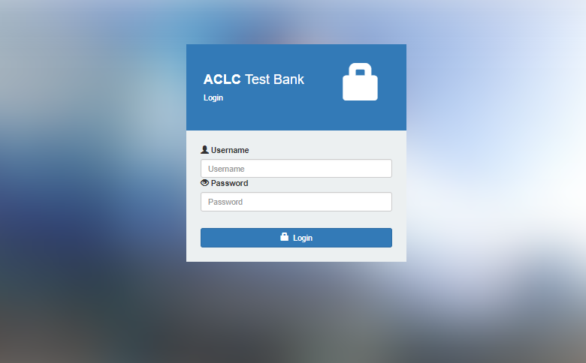
Step 1: Login

Slide 9
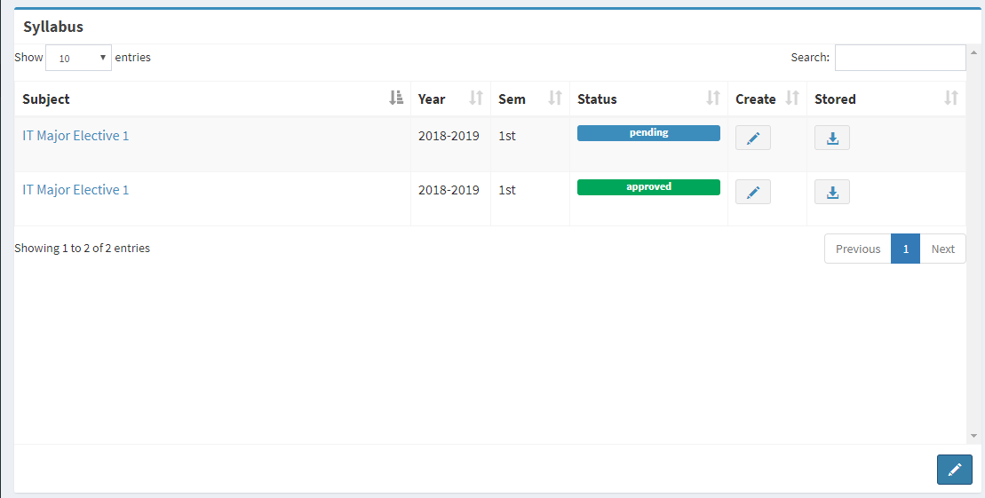
Step 2: Add Subject
Click to Add Subject

Slide 10
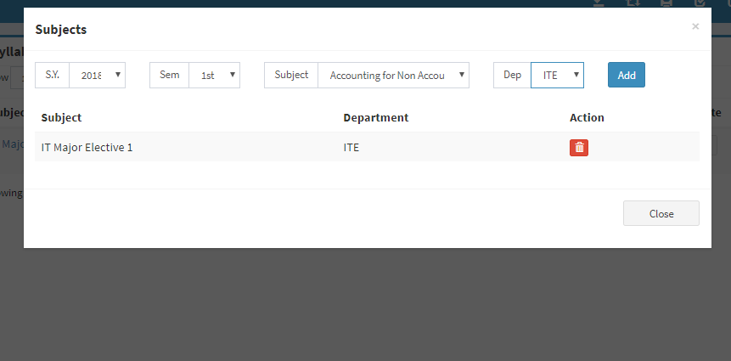
Step 2: Add Subject
1.Select SY, Sem, Subject and Department
2.Then Click adda

Slide 11
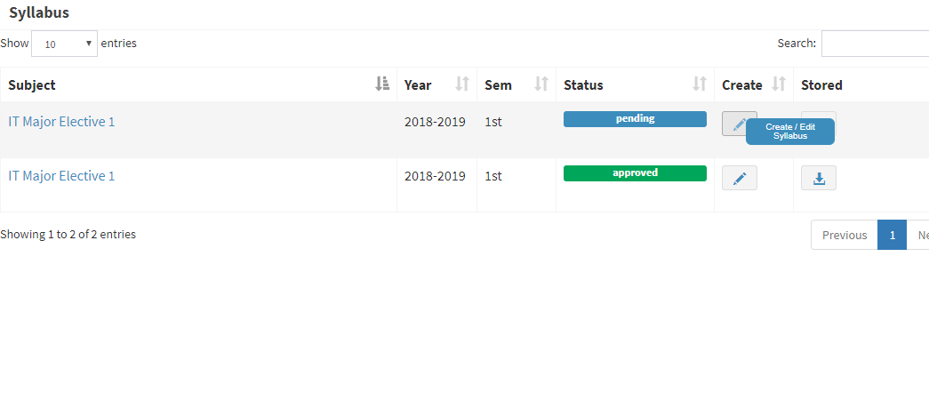
Step 3: Create Syllabus
Click to Create Syllabus

Slide 12
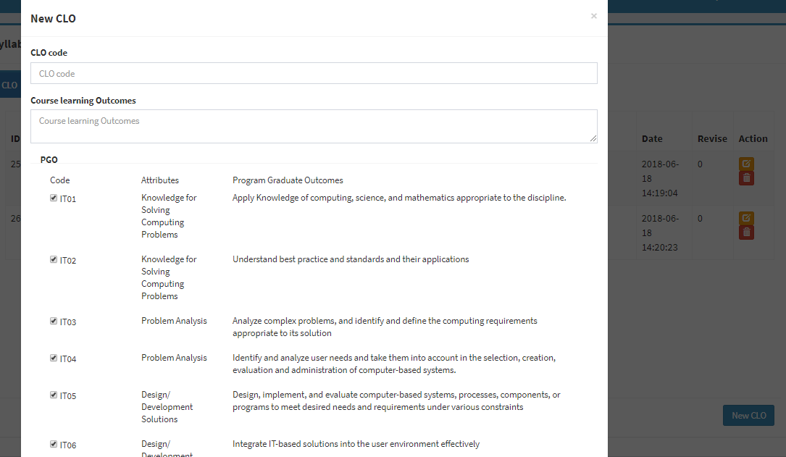
Step 3: Create Syllabus
2.Fill-up all fields and click save
1.Click to Create CLO

Slide 13
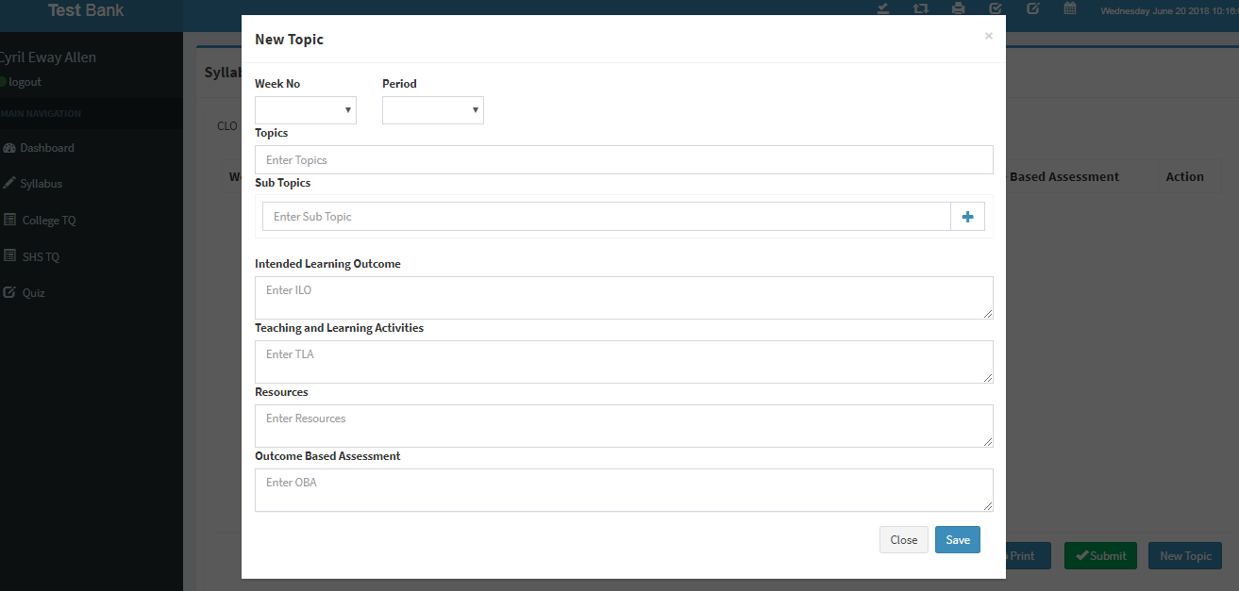
Step 3: Create Syllabus
2.Fill-up all fields
3.Click to Save topic
1.Click new TOpic

Slide 14
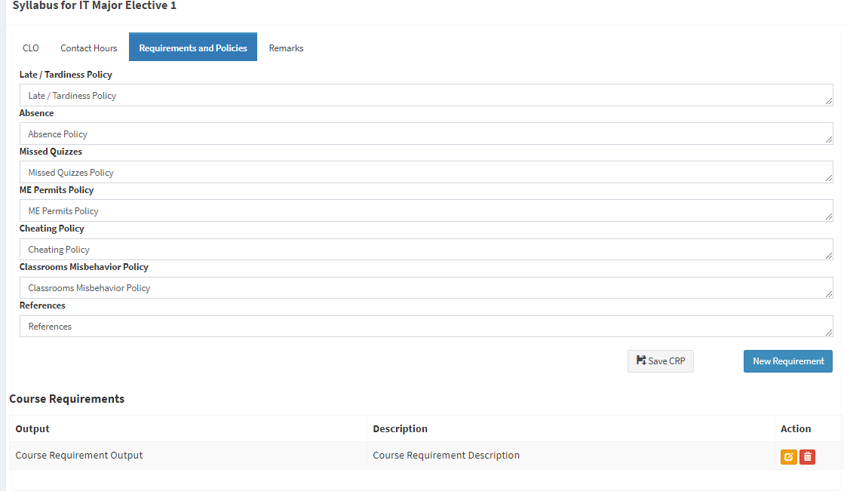
Step 3: Create Syllabus
1.Click to Save policies
2.Cick to add new requirement

Slide 15
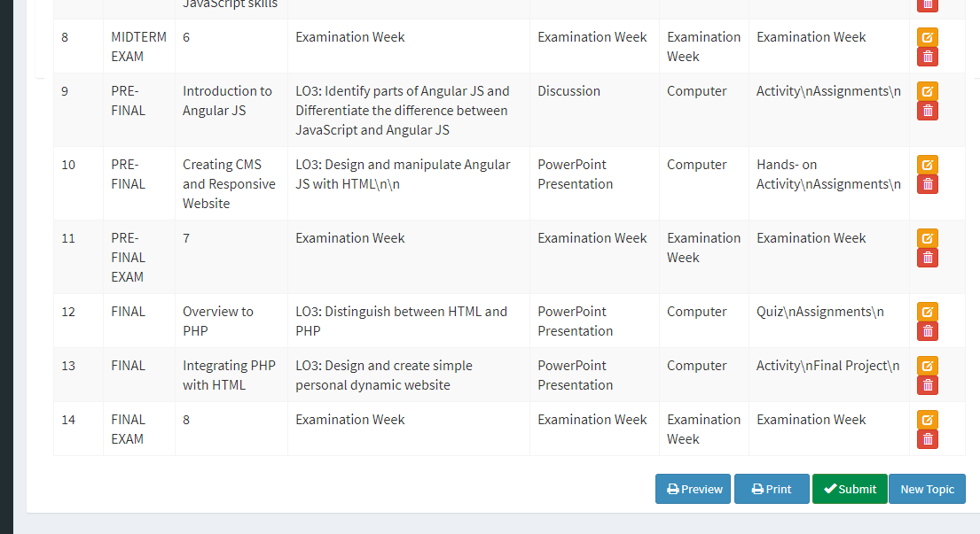
Step 3: Create Syllabus
In Contact Hours tab Click to submit for checking

Slide 16
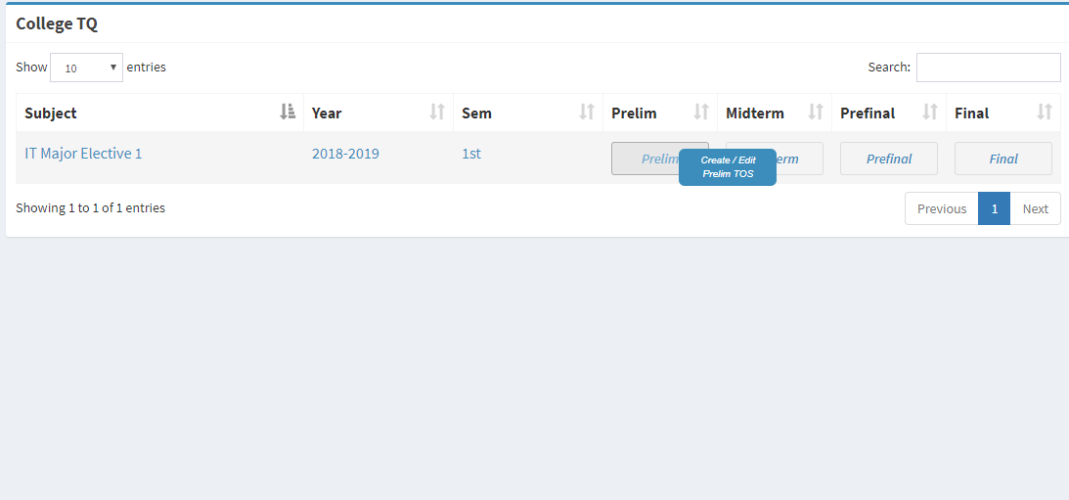
Step 4: Create TOS
Click to Create TOS

Slide 17
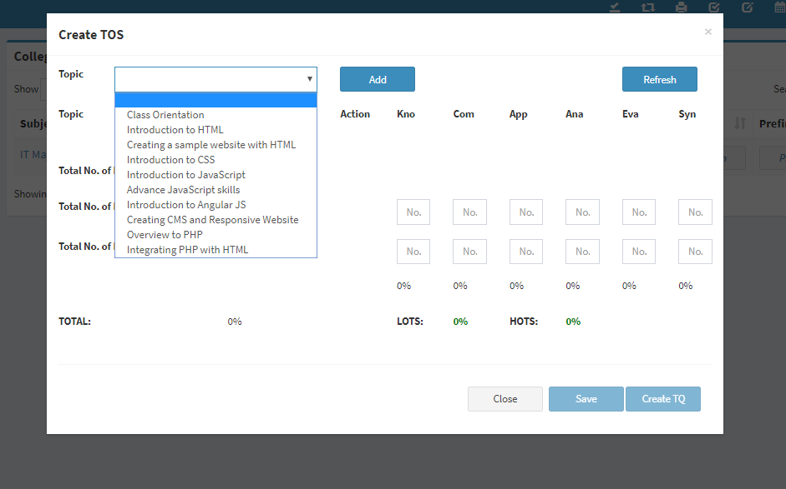
Step 4: Create TOS
Select topic and click Add

Slide 18
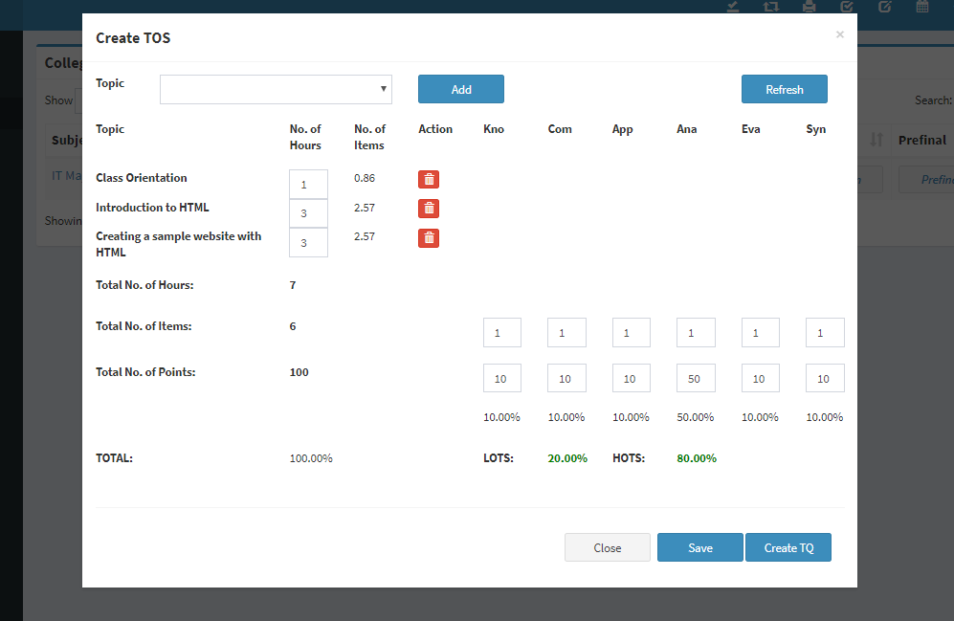
Step 4: Create TOS
1.Fillup the required data then click save
2.Click Create TQ after saving

Slide 19
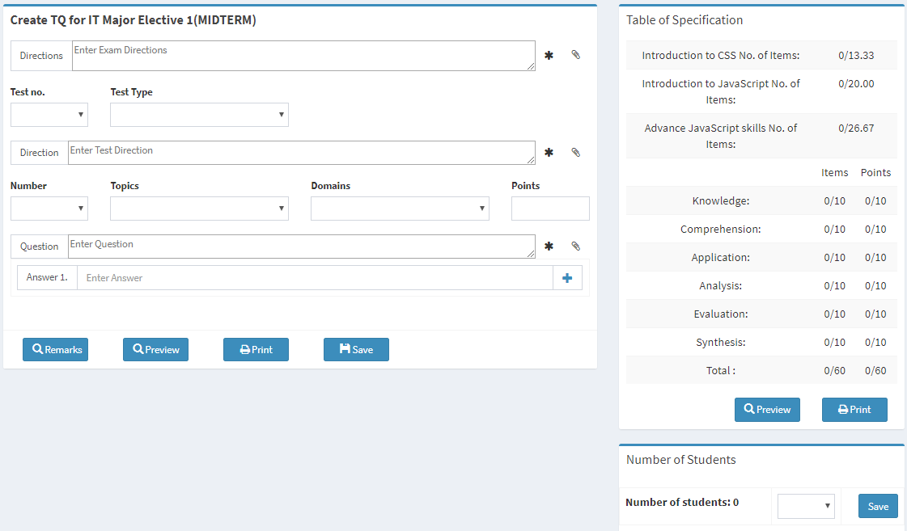
Step 5: Create TQ
Fillup the required data
TOS Guide
Click save to save data
Submit Button will appear when TOS is fulfilled
Select number of student then save

Slide 20
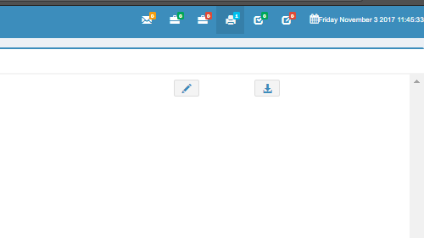
Step 5: Create TQ
Notification when TQ is Printed

Slide 21
PROGRAM HEAD

Slide 22
Login

Slide 23
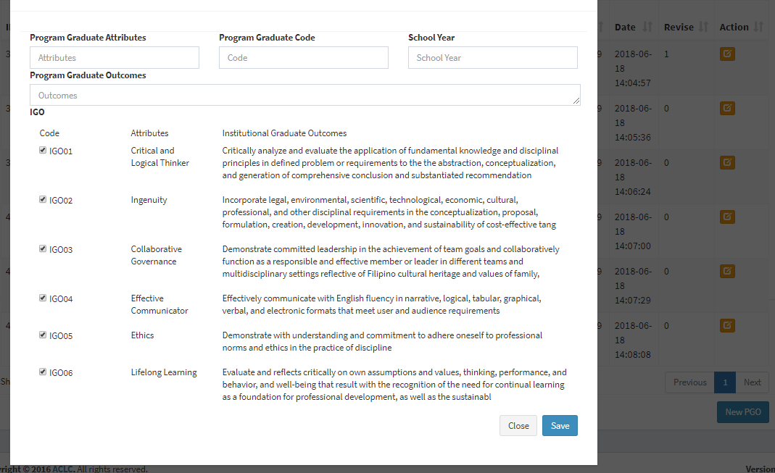
Create PGO
Click to add new PGO
Click to save new PGO

Slide 24
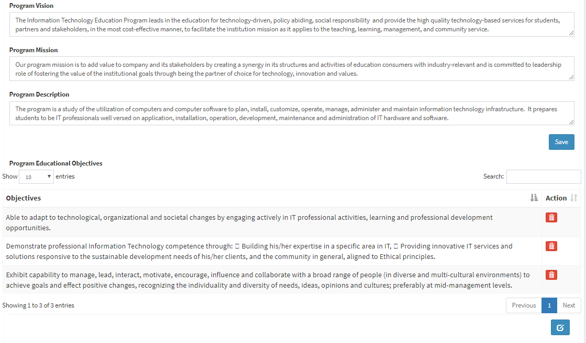
Set Program Information
Click to save data
Click to add objectives

Slide 25
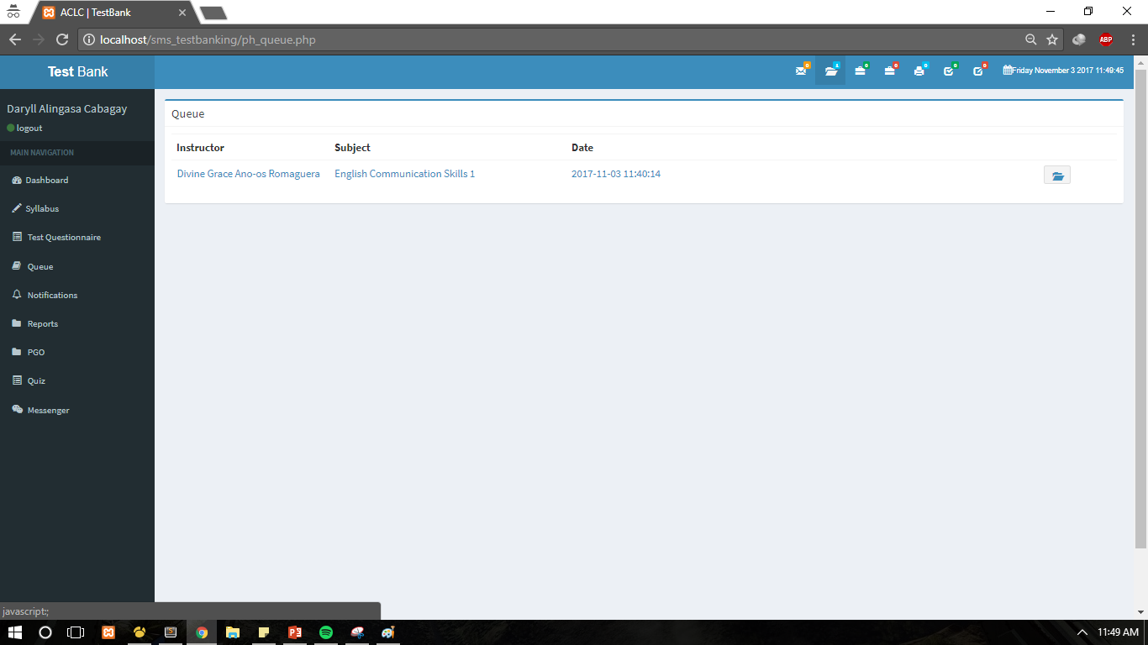
Checking TQ and TOS
Click to check TQ & TOS

Slide 26
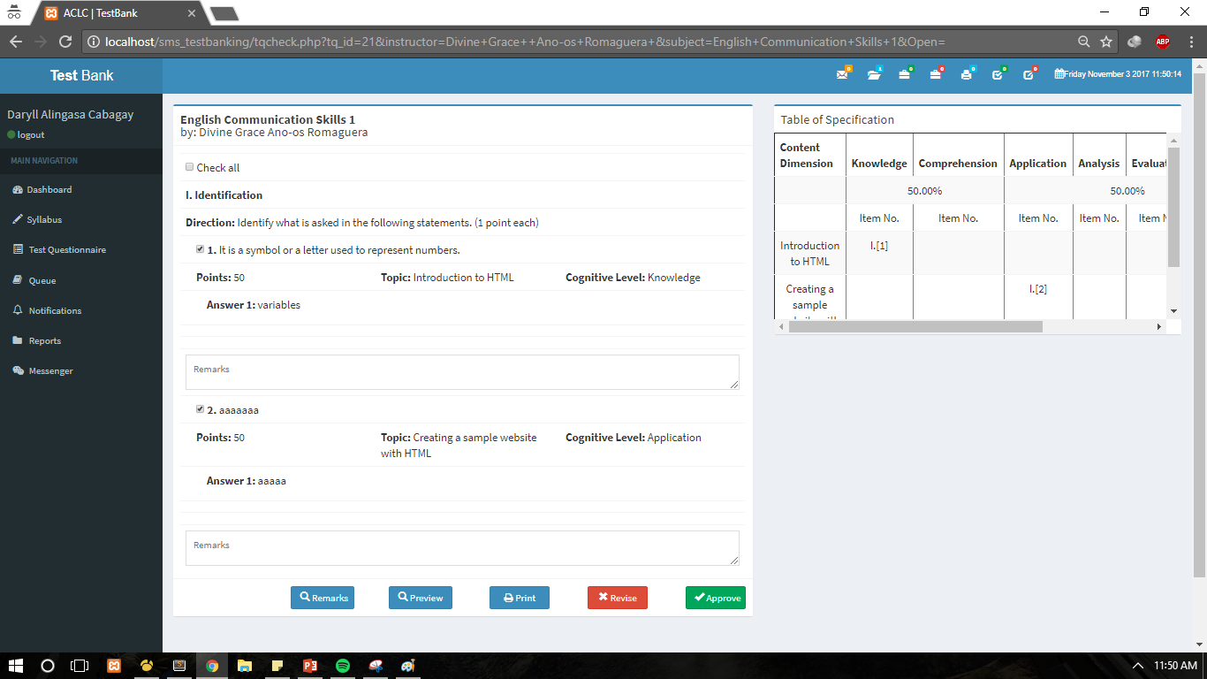
Checking TQ and TOS
TOS Guide
Click to revise
Click to approve

Slide 27
DEAN

Slide 28
Login

Slide 29
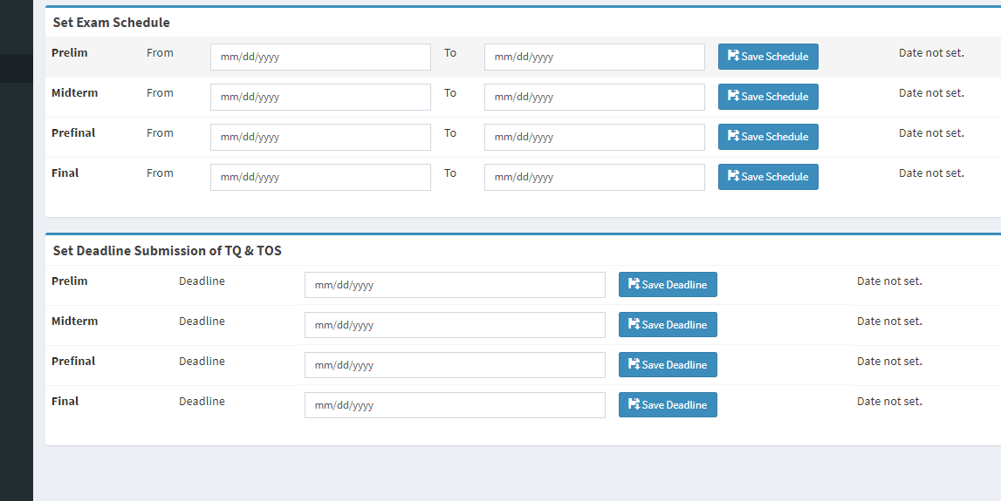
Set Exam & Submission Date
Set Exam Schedule date then save
Set Submission Deadline date then save

Slide 30
Create PGO
Click to add new PGO
Click to save new PGO

Slide 31
Set Program Information
Click to save data
Click to add objectives

Slide 32
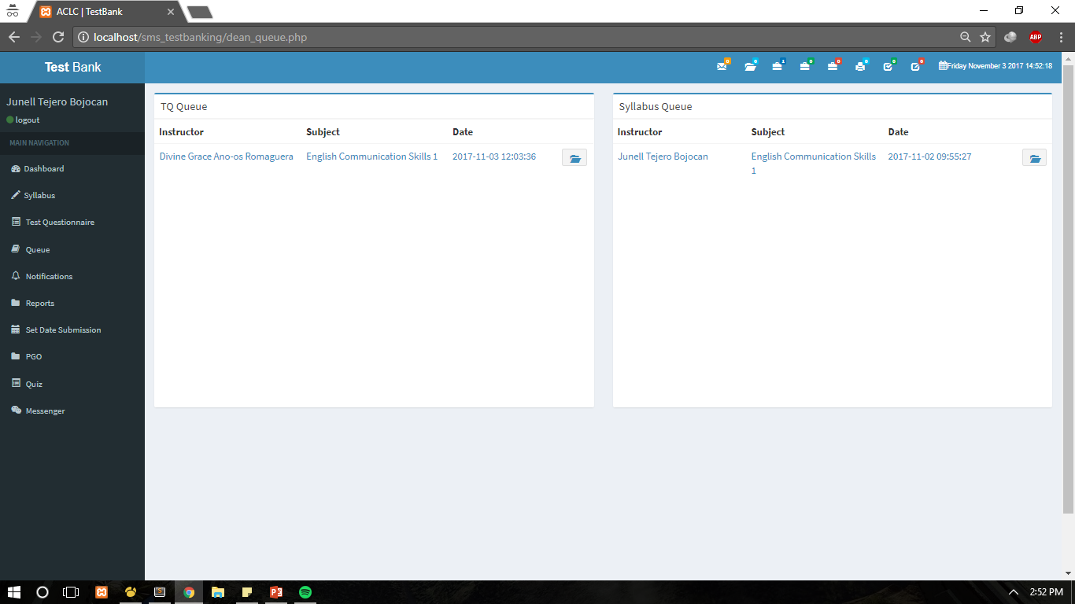
Checking TQ and TOS / Syllabus
Click to check TQ & TOS
Click to check Syllabus

Slide 33
Checking TQ and TOS
TOS Guide
Click to revise
Click to approve

Slide 34
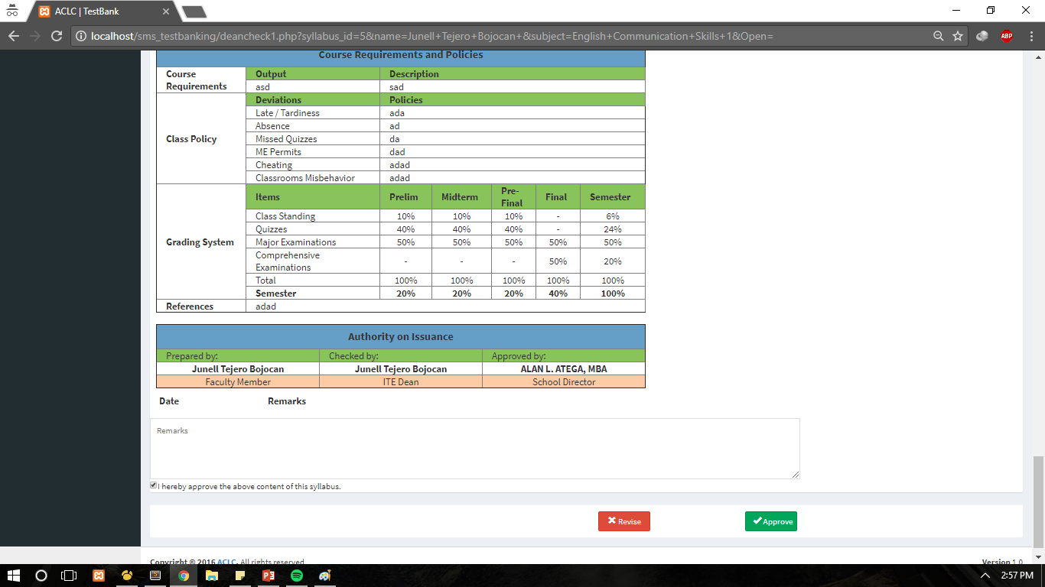
Checking Syllabus
Check to verify approval
Click to revise
Click to approve

Slide 35
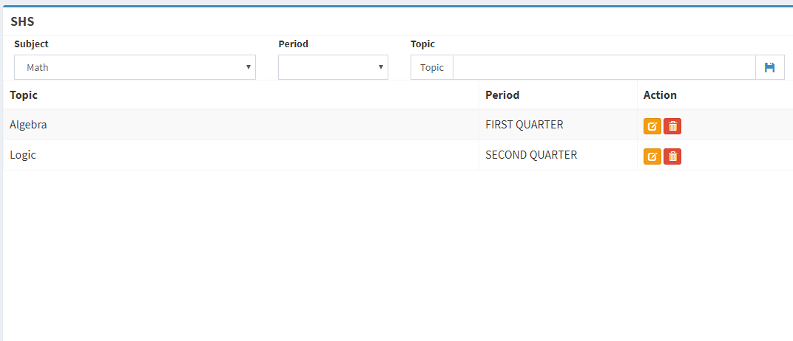
Set Topic for SHS
Select Subject
Select Period
Enter Topic then Save

Slide 36
PRINTING INCHARGE

Slide 37
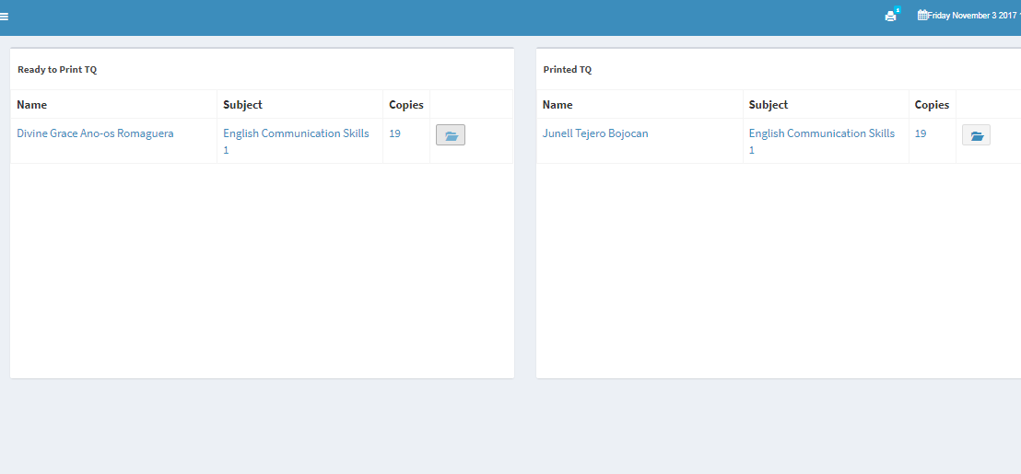
Printing
Click to preview TQ
Click to reprint printed TQ

Slide 38
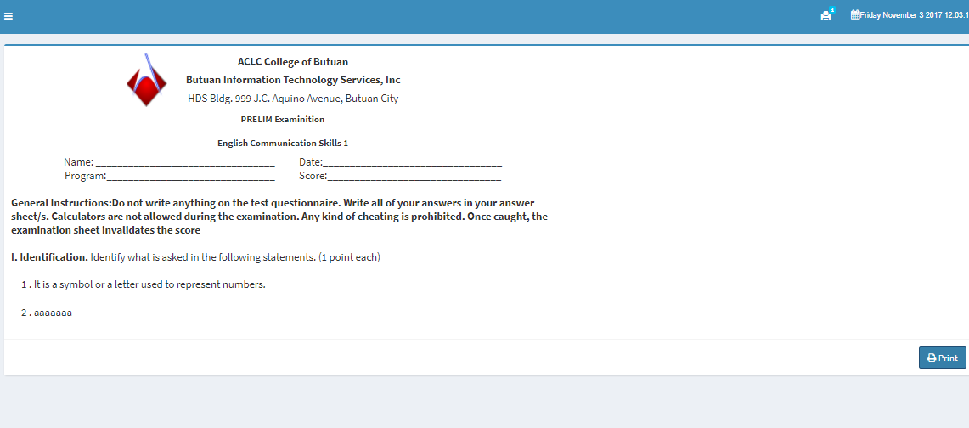
Printing
Click to print TQ

